Slide 1
基于K8S的PaaS平台企业应用实践

Slide 2
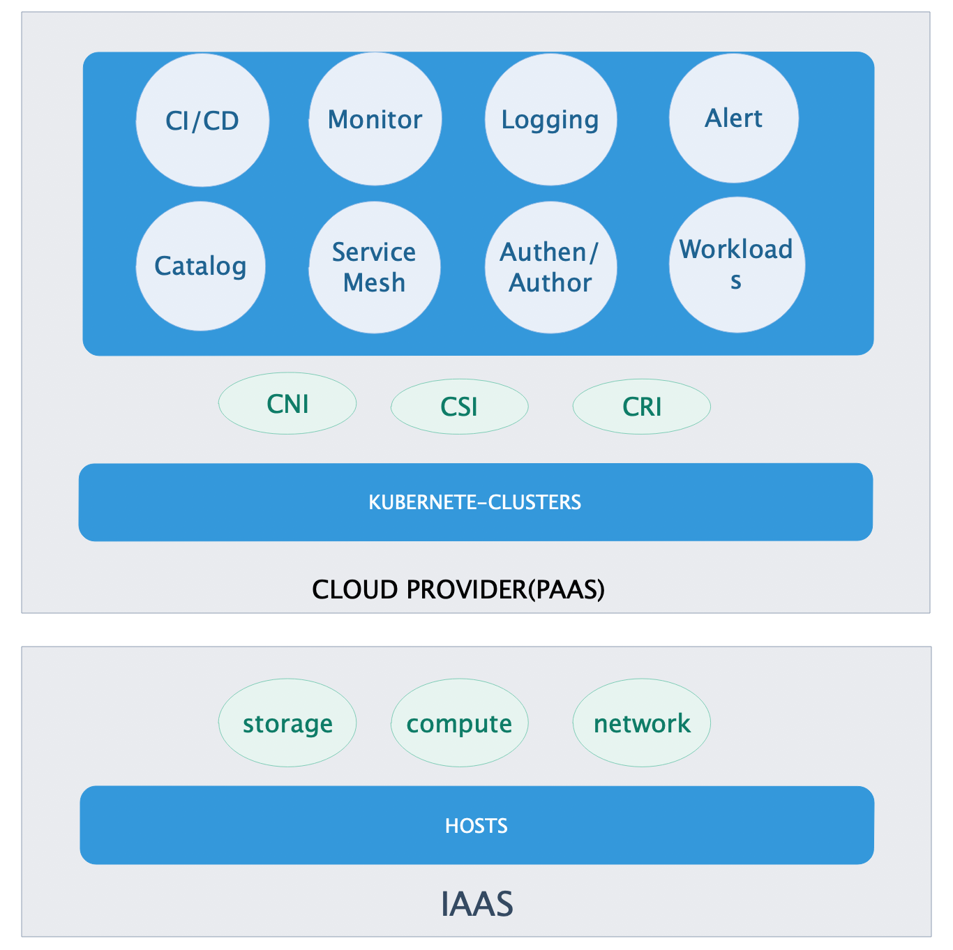
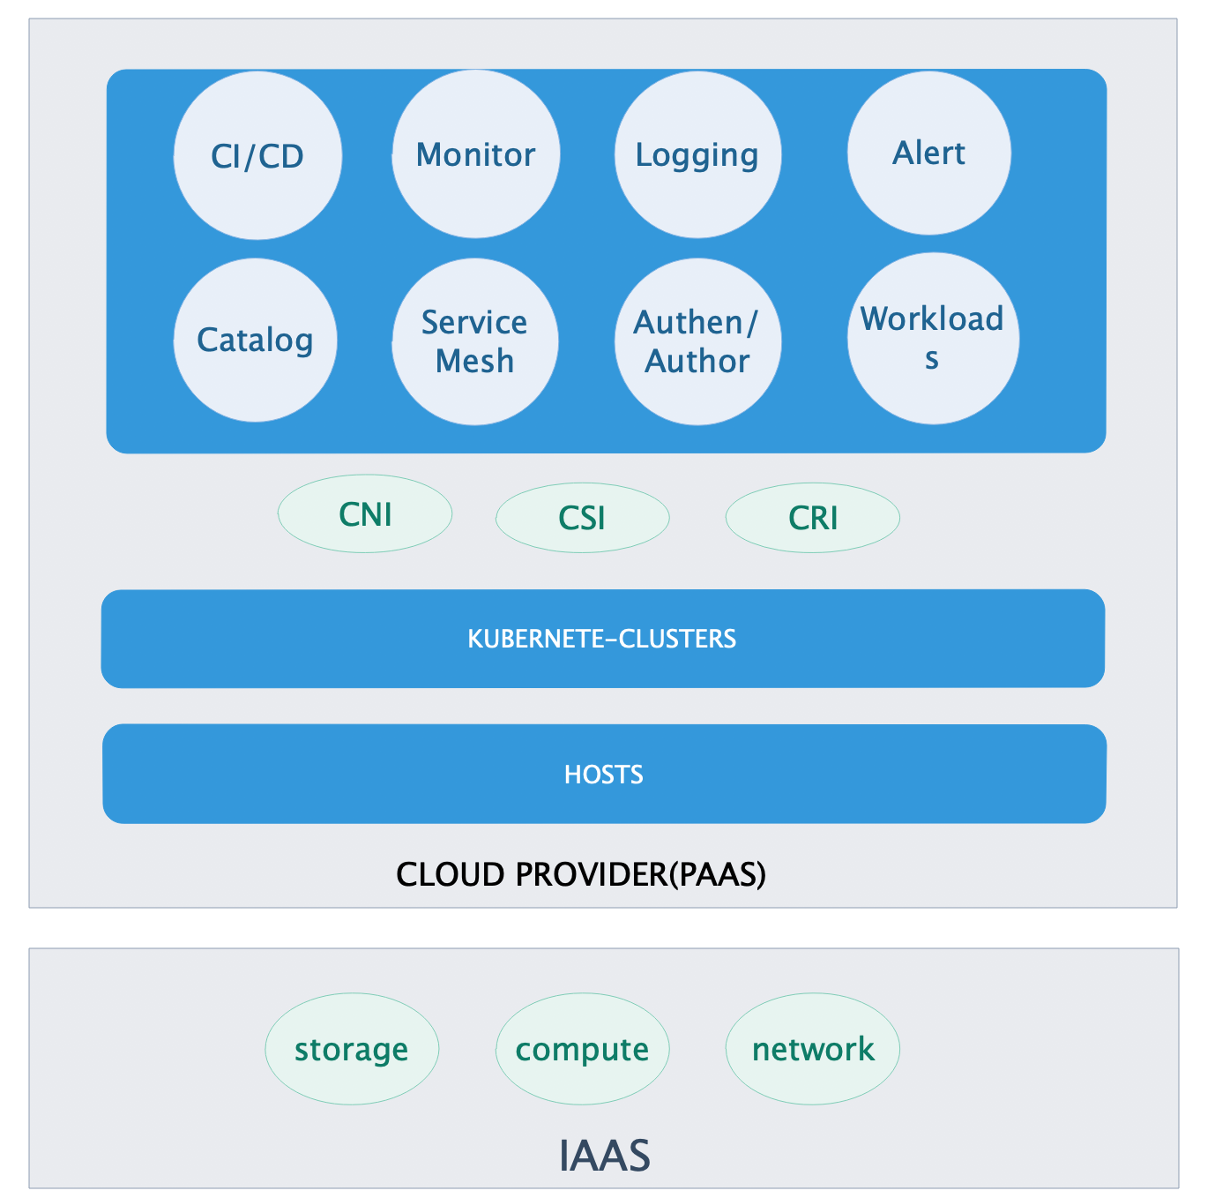
General Overview

Slide 3
CNI
01
Flannel
02
Calico
03
Canal
04
MACvlan

Slide 4
CSI
01
Amazon EBS Disk
02
Azure Disk
03
Google Persistent Disk
04
NFS Share
……

Slide 5
CRI
01
CRI-O
02
RKTLET
03
FRAKTI
04
DOCKER CRI SHIM

Slide 6
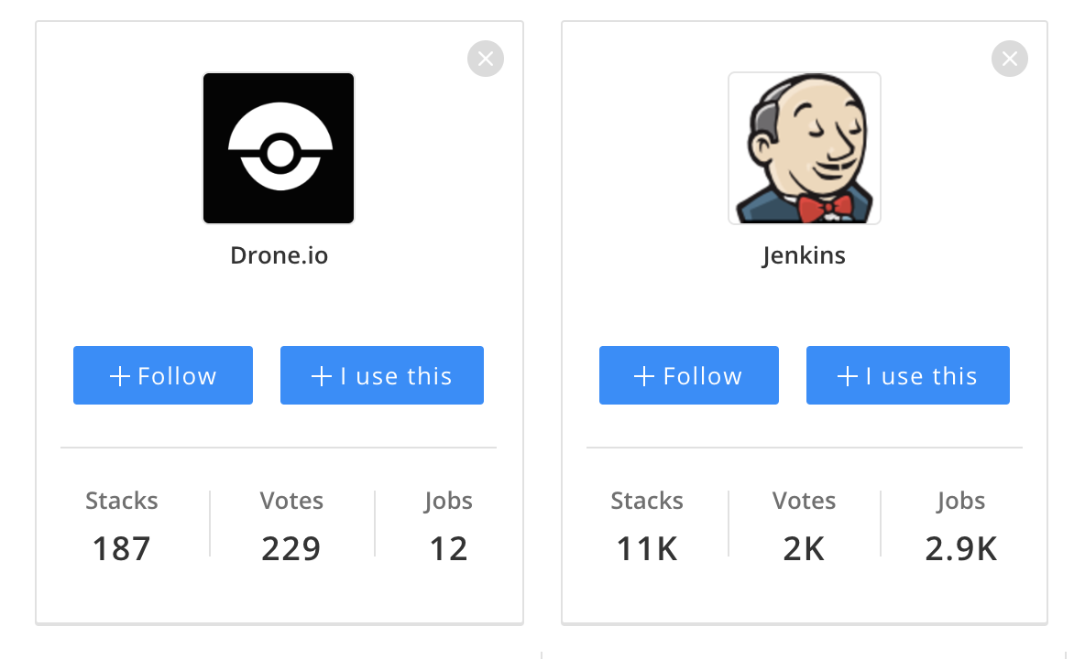
CI/CD

Slide 7
Monitor/Alert

Slide 8
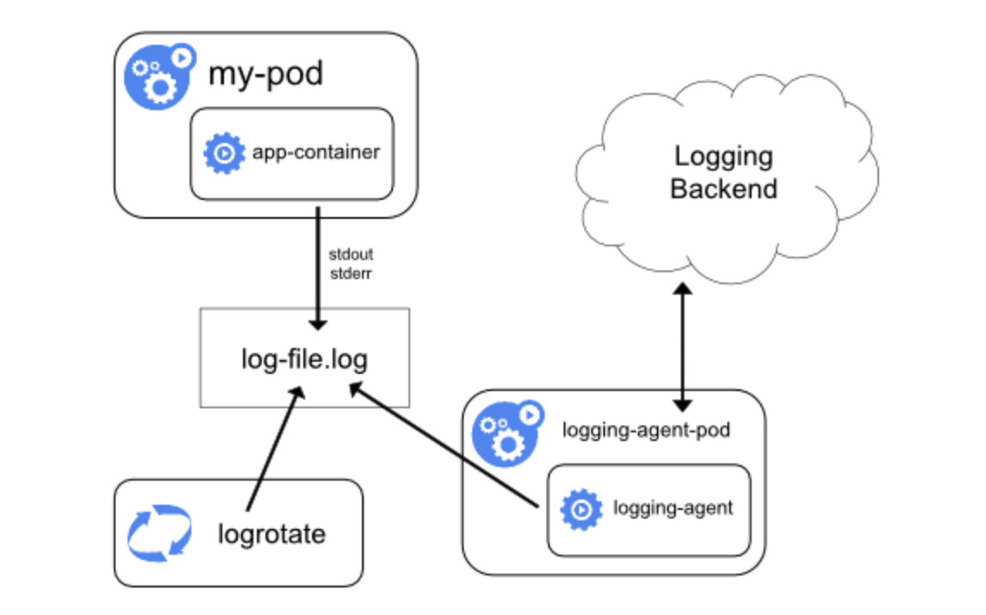
Logging
fluentd
logstash

Slide 9
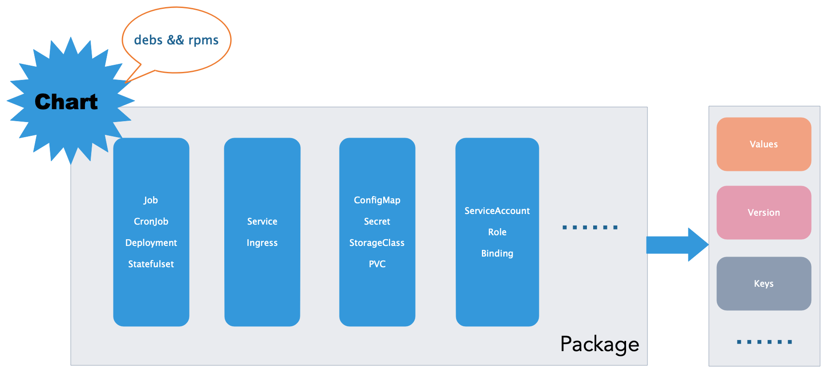
Catalog

Slide 10
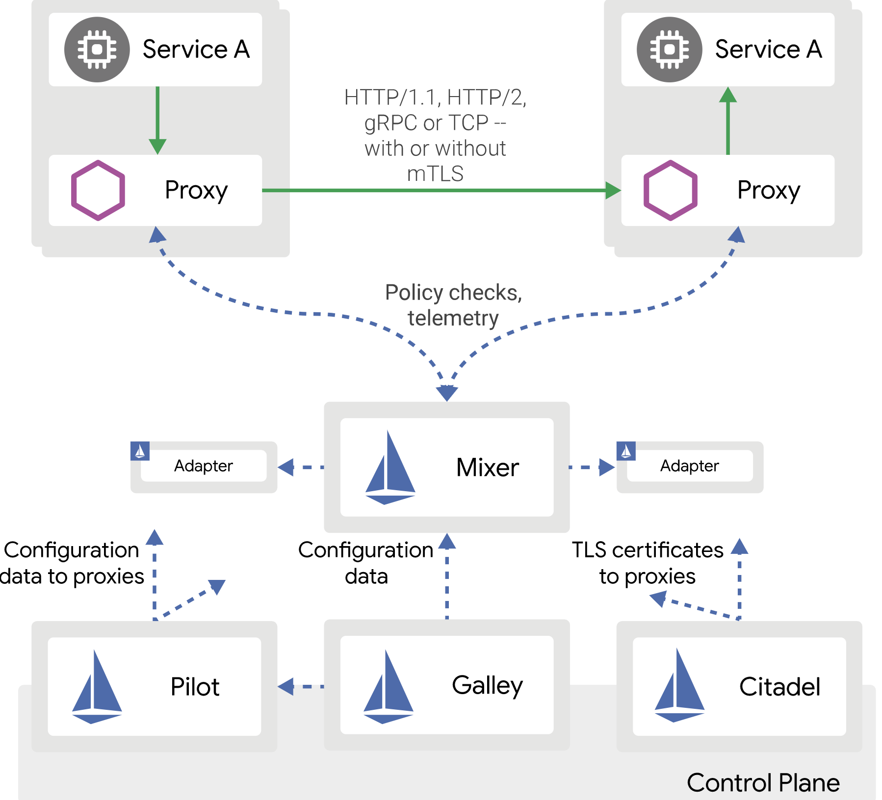
ServiceMesh

Slide 11
Workloads
01
Workloads
02
LoadBalance
03
Service
04
HPA

Slide 12
Authenticate/Authorize
Multi-user
Multitenancy

Slide 13
Thank you

